Slide 1


DIGITAL & DATA LEADERS SURVEY ANALYSIS
Team 6
Members:
Lam Quang Thinh
Nguyen Tan Loc
Jingyu Zhang
Haoyuan Li
Aastha
Rohit Singh
Anidya Bhandari
Notes:
Aastha

Slide 2


TABLE OF CONTENTS
1. Introduction
2. Data Analysis
3. Appendices
Notes:
Aastha

Slide 3
INTRODUCTION
PROJECT SUMMARY
The project aims to illustrate the current state of
data and digital solutions of New Zealand in 2020 and 2022
Outline
Data processing
Combine the dataset based on relevant questions.
Data Analysis
Provide comparison for the differences between 2020 and 2022. Emphasise on key insights in 2022
Conclusion and Recommendation
Provide conclusions and potential suggestions. Restrictions also addressed
Notes:
Aastha

Slide 4


2.1 Combined dataset for 2020 and 2022
2. DATA
ANALYSIS
z
2.2 Comparisons for 2020 and 2022
2.3 Insights for 2022
Notes:
Rohit

Slide 5


2.1 Combined dataset for 2020 and 2022
Logic | Methods | Results
Identify common questions in 2020 and 2022. Process data so the values match in the two years Merge the two datasets by rows. | List out all the questions Group the questions into categories Standardise the data Combine the datasets | The combined dataset includes: 15 columns 166 observations (72 respondents in 2020 94 respondents from 2022)
Notes:
Rohit

Slide 6
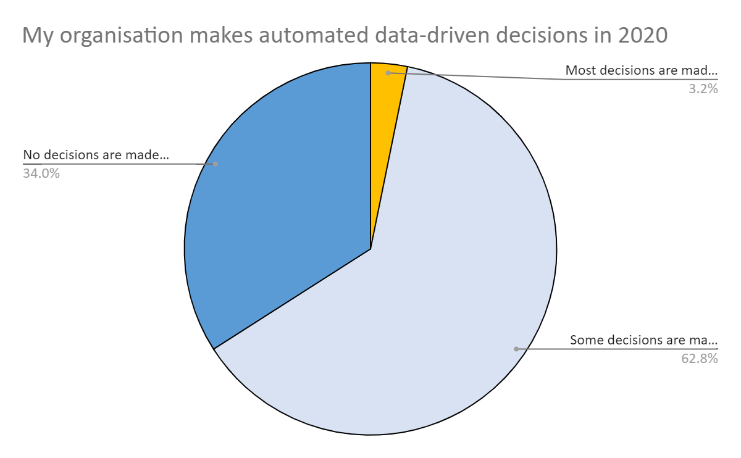
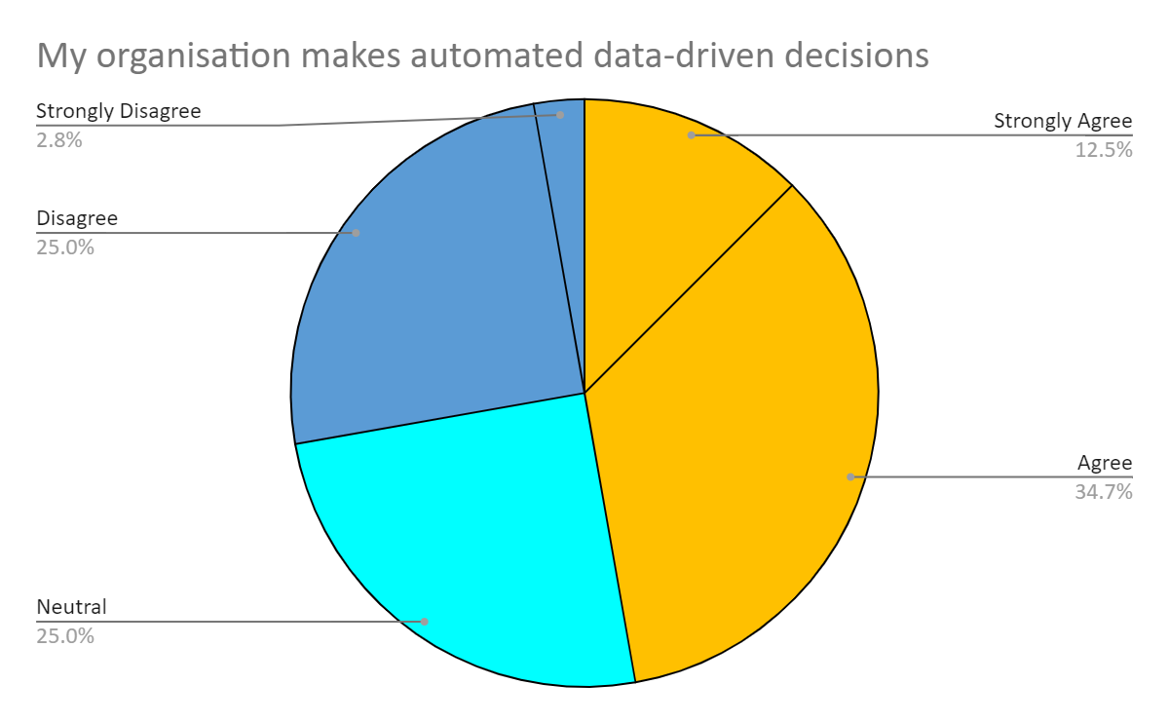
2.2 Comparisons (2020 & 2022)
General
In 2020, 34.04% of companies reject making automated data-driven decisions.Then, in 2022, the rate of disagreement to automated data-driven decisions reduces to 25%.
In 2020, 34.04% of companies reject making automated data-driven decisions. Then, in 2022, the rate of disagreement to automated data-driven decisions reduces to 28%.
→ The importance of data in decision making process is enhanced
Notes:
Jing

Slide 7
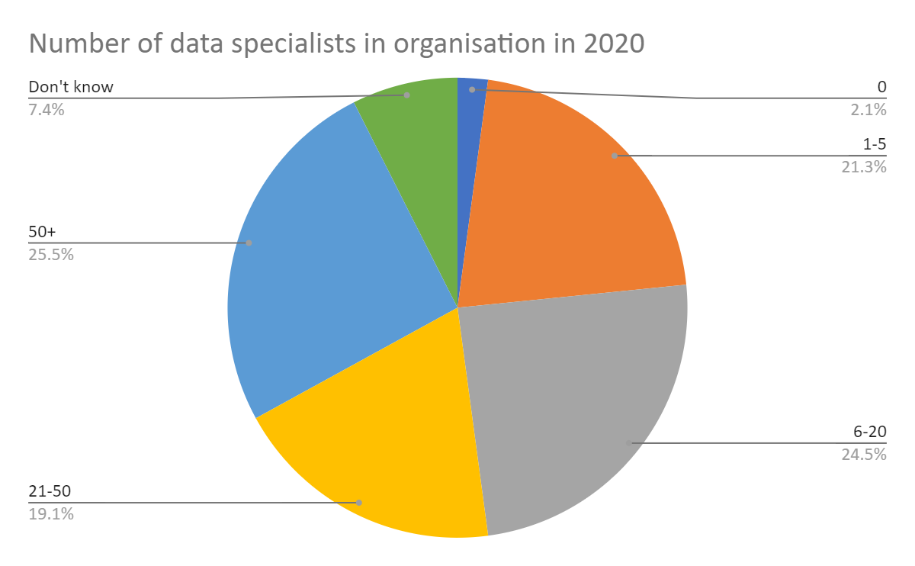
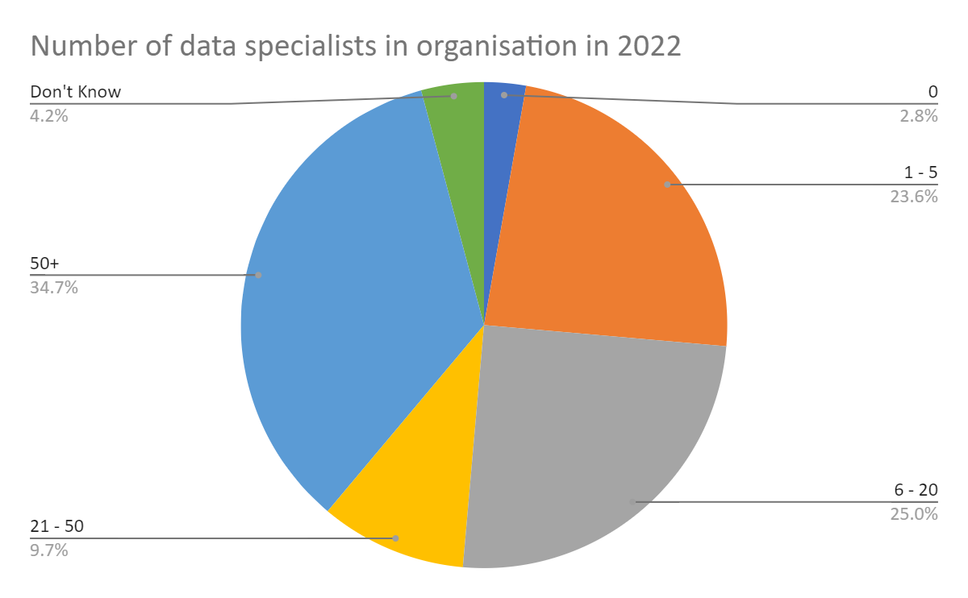
2.2 Comparisons (2020 & 2022)
Human Resources
. The portion of organizations with 50+ specialist have increased from 25.53% in 2020 to 34.72% in 2022. The cause of this shift might be predicted that part of the organizations having 21-50 specialists is converted to the organisations with 50+.
Notes:
Jing

Slide 8
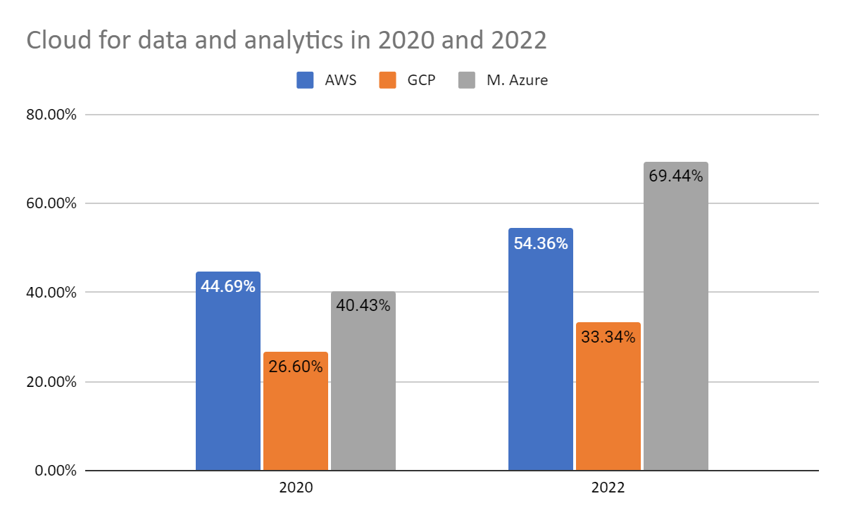
2.2 Comparisons (2020 & 2022)
Technologies
Organisations appear to use Cloud more.
→ Cloud usage takes a higher role in organisations from 2020 to 2022.
In 2020, AWS was the most popular of 44.69%
In 2022, Microsoft Azure surpassed AWS
→ The market is more competitive or there is a change in the demand of organisations
Notes:
Jing

Slide 9
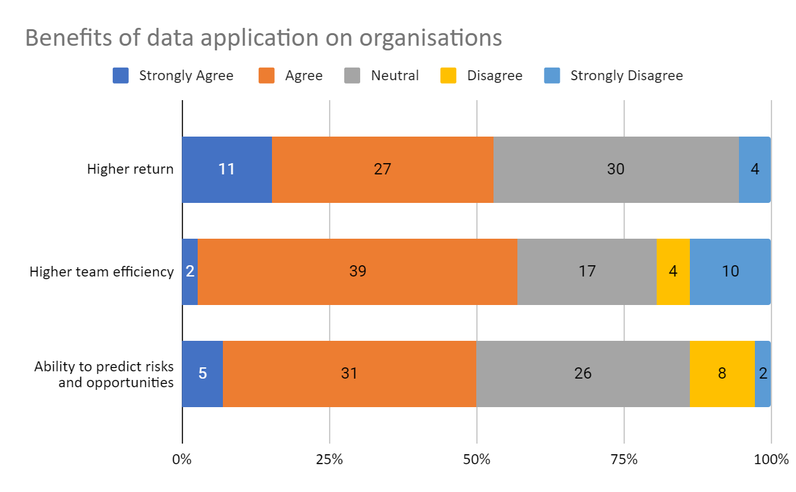
2.3 Insights for 2023
Benefits of data application
96% have higher return on investments by making decisions based on data.
→ Maximizing business’s revenue
90% have increased sufficiently across teams as a result of process automation.
→ Optimizing the performance of human resources
90% confirm that they can more quickly find out the risks and opportunities.
→ Preventing risks and utilizing opportunities
Notes:
Talu

Slide 10
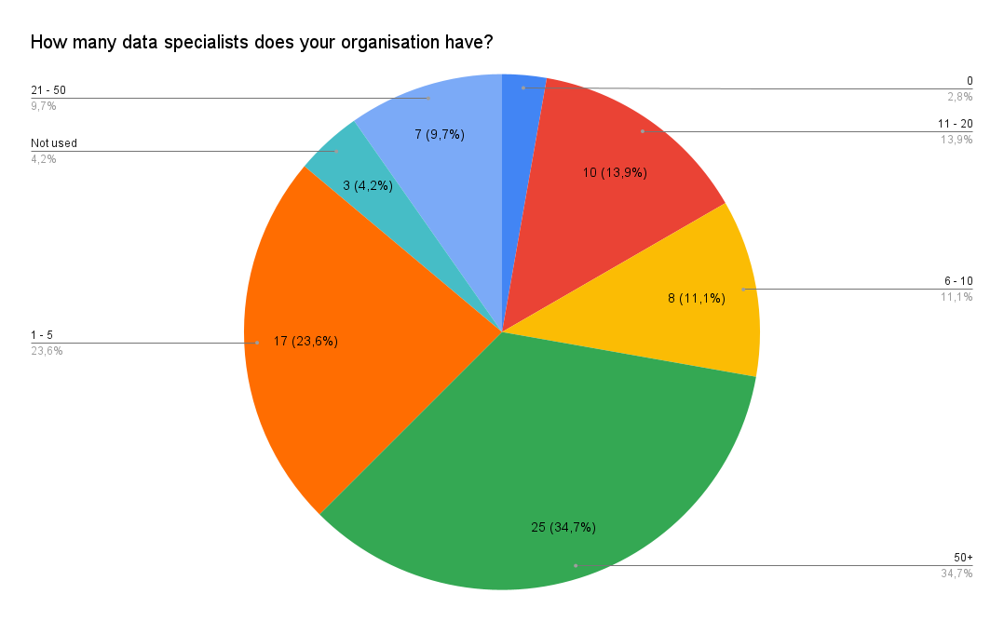
2.3 Insights for 2023
Human resource
Just 2.8% of organisations nowadays do not have data specialists.
→ Data positions are necessary in almost every organisation
just 2.8% of organisations nowadays do not have data specialists.
Notes:
Talu

Slide 11
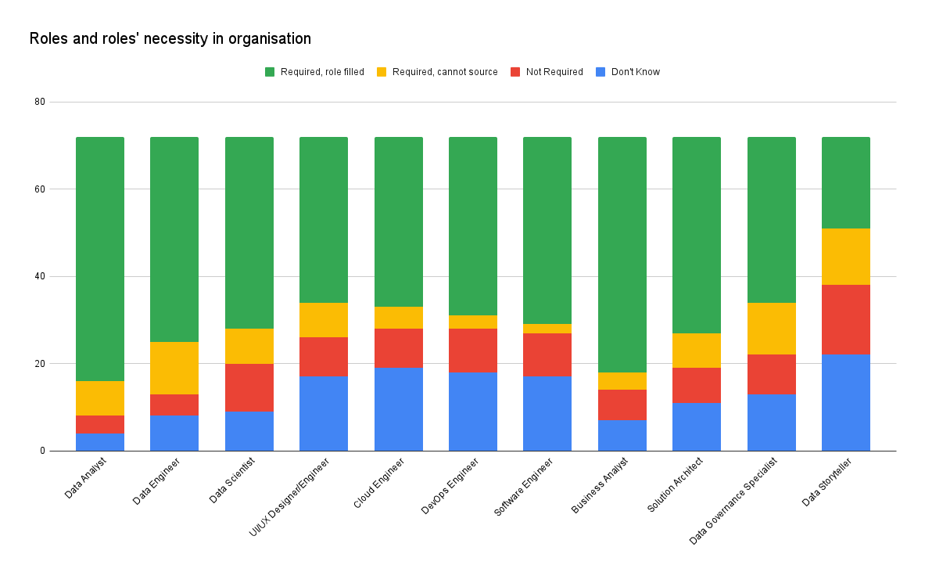
2.3 Insights for 2023
Human resource
Around 10% of organizations that are in need of Data Engineer, Data Governance Specialist, and Data Storyteller but cannot source
just 2.8% of organisations nowadays do not have data specialists.
→ Beside Data Analyst, there are still many opportunities for other roles of data specialists that are in high demand in organizations
Notes:
James

Slide 12
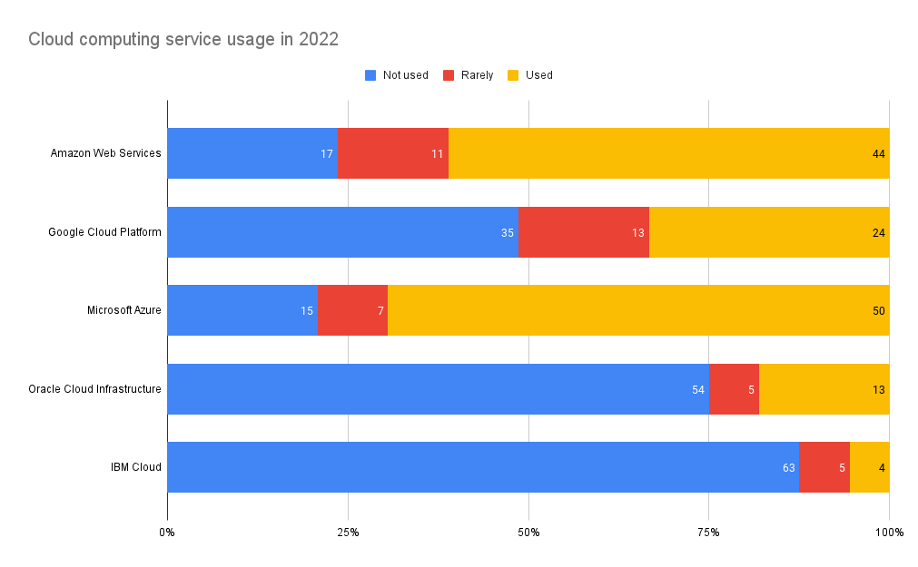
2.3 Insights for 2023
Technologies
Amazon Web Services (AWS), Google Cloud Platform (GCP), and Microsoft Azure are being utilised by most organisations, recognized by 44%, 24%, and 50% of Cloud computing service usage in 2022, respectively
→ Decide which technology to learn and master can enhance self employability
Notes:
James

Slide 13
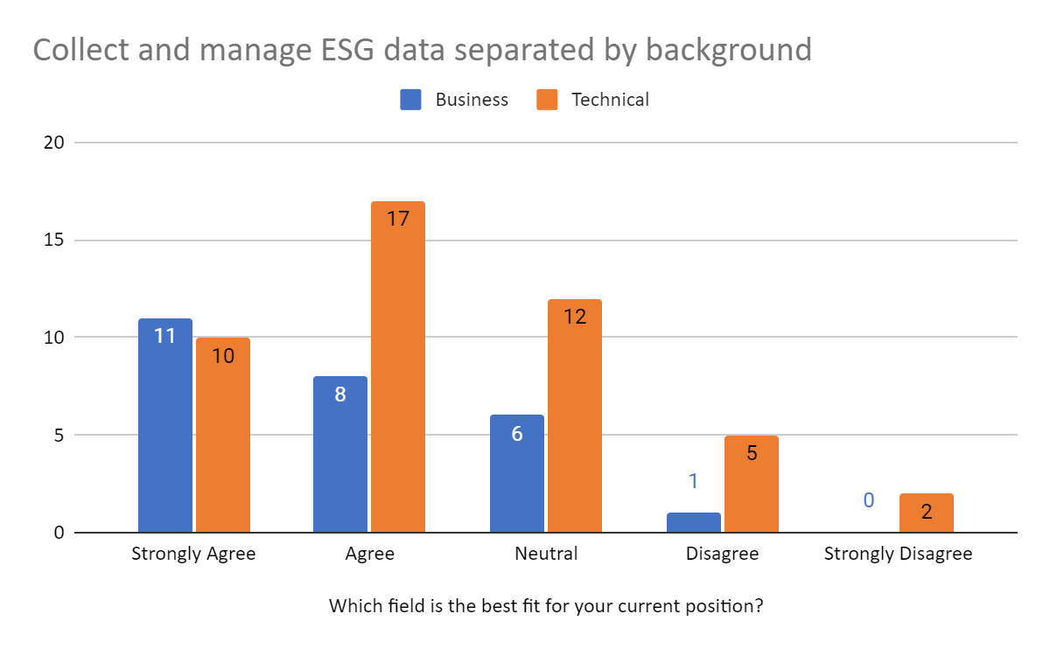
2.3 Insights for 2023
Collecting and storing data
The majority, regardless of business and technical background, has the intention to Agree and Strongly Agree that the organisation should collect and manage ESG data.
→ Data leaders pay attention the Environment and Society
→ Businesses are able to grow sustainably and contribute to society
Notes:
James

Slide 14


Recommendations
→ Understand self’s strengths
→ Understand the market demand
→ Make efforts and be well-prepared
For Data Specialist
Notes:
James

Slide 15

Recommendations
→ Optimize automated decision making process
→ Utilize data for risk detection
→ Grow sustainably and contribute to society
For Business
Notes:
James

Slide 16

Incompatible response design
Limitations
Lack of organization’s information
Challenging to clarify a trend
Notes:
James

Slide 17

COMBINED DATASET
DATA CODING

Slide 18
REFERENCE LIST
Bean, Randy. “How Companies Say They're Using Big Data.” Harvard Business Review, 28 April 2017, https://hbr.org/2017/04/how-companies-say-theyre-using-big-data. Accessed 6 December 2022.
“ESG data: why is it important and what is its future?” BNP Paribas CIB, 15 January 2021, https://cib.bnpparibas/esg-data-why-is-it-important-and-what-is-its-future/. Accessed 6 December 2022.
Gates, Bill, and Collins Hemingway. Business @ the Speed of Thought: Using a Digital Nervous System. Penguin, 1999. Accessed 6 December 2022.
“Home.” YouTube, https://zeenea.com/the-must-have-roles-for-the-perfect-data-analytics-team/?fbclid=IwAR3xTH6Jv7P6tkY77KVKiDPuZqNVLep1XzkQd4KJP7W55Ya9IYhQwrGNgug. Accessed 6 December 2022.

Slide 19

THANK YOU
We would love to answer your enquiries

